Slide 1


Mantid Scientific Steering Committee
Nick Draper
17/02/2011

Slide 2
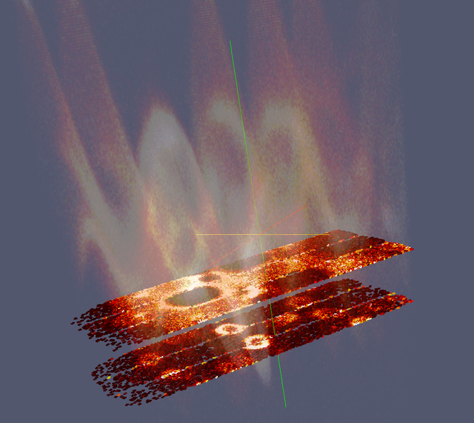
This Release
Target Date
  27th January 2012
Huge release
  4 months development
  808 tickets (474 previous)
Major Release
  Increased functionality
  Greater Testing
Actual Release Date
  3rd February 2012
  Dropped back by 1 week to accommodate scientists requests

Slide 3


This Release
Requests
  Both Facilities
    Improved Python interface
    Floating Windows
  ORNL
    Improved VATES interface & mslice funtionality
    Combine the Mantid & Vates installers
    Allow Multiple Mantid versions
  ISIS
    Muon Improvements
    Direct Inelastic Improvements

Slide 4
Progress over the last iteration
Installation
  Windows Installer
    Admin rights not required
      However uninstalling the last version does
      (error code 2349)
    Vates installer still separate
  Multiple RHEL6 versions
    MantidPlot
    MantidPlotNightly
    MantidPlotUnstable (SNS only)

Slide 5
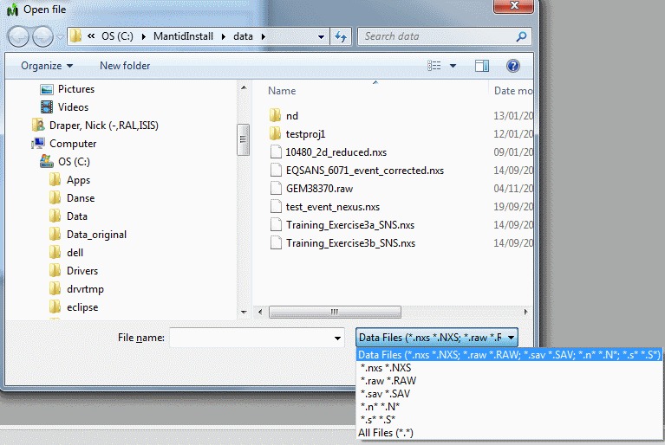
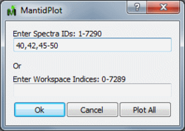
Progress over the last iteration
UI Changes
  Default File type is all common extensions for a facility.
  Workspace List can now be sorted
  Algorithms have been recategorised
  Plot Spectra Dialog

Slide 6
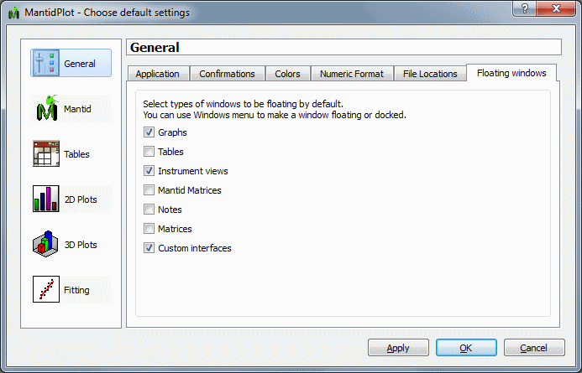
Progress over the last iteration
UI Changes
  Floating Windows
  Can be controlled for individual windows using the window menu
  Preferences set for window types
    Default off on linux

Slide 7
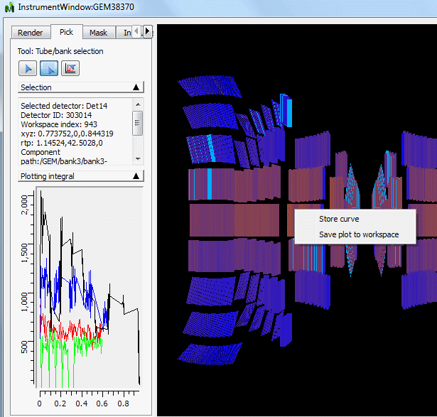
Progress over the last iteration
UI Changes
  Instrument view
    New axes for banks/tubes
      Det id, tube length, phi
    Store Curves
    Export Curves->workspace
    Display peak lists
    Flip unwrapped view

Slide 8
Progress over the last iteration
Framework
  Group workspaces
    work with all binary operations
    Improved access to members from python
  ISIS Events
    Improved support for ISIS “fine bin” events
  Projects
    All associated files are saved within a folder
    EventWorkspaces, V3D (positions) and Quat (rotations)
  Signed Theta
    Supported for reflectometers
  Stability
    Fixed many memory leaks and race conditions

Slide 9



Progress over the last iteration
Python Scripting
  New API (from mantid.simpleapi import *)
    Algorithm functions now return their outputs
    Still possible to work the old way
      Using named args
    Much easier to extract data to numpy and creaate workspaces using CreateWorkspace
    Some functionality moved
    Documentation
      New Python manual
      Training material updated

Slide 10
Progress over the last iteration
Python Scripting
  Old API (from mantid.simple import *)
    Can be enabled in scripts
    Or by setting a preference
    Intellisense help updates dynamically
  Plotting Improvements
    Much greater control of graph and line appearance
  Ipython
    Preview install available for early adopters

Slide 11
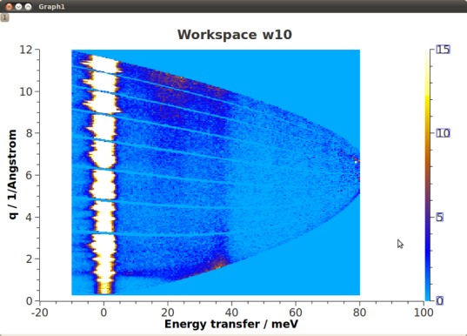
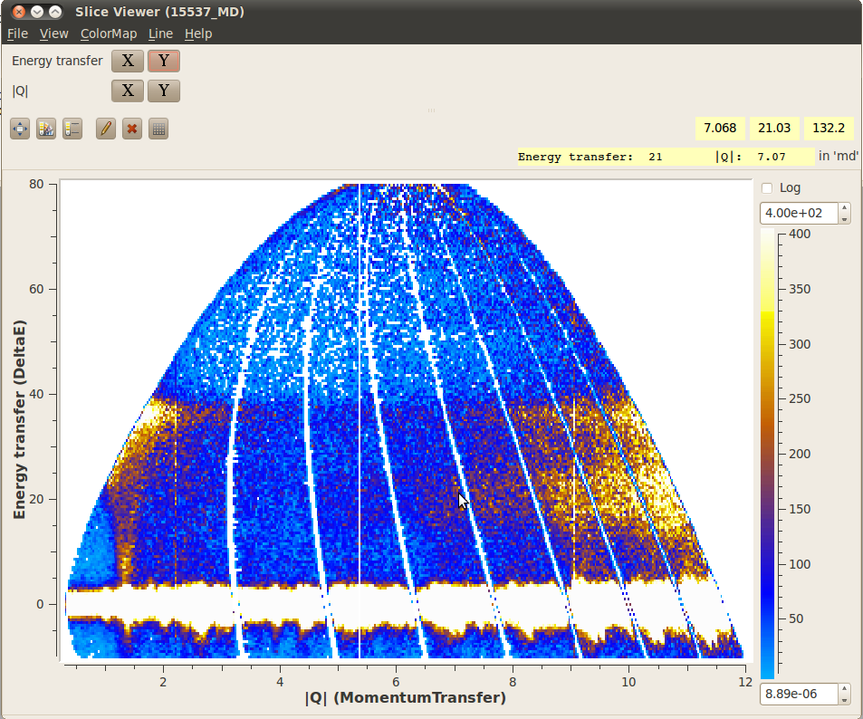
Progress over the last iteration
Direct Inelastic
  Diagnostics have been updated and validated to match libISIS
    Much greater control of parameters added in python
  SofQW2
    2D rebinning
      ↑ Speed
      ↑ Accuracy
    Output can be fed to Sliceviewer
      Via ConvertToMDEvents
  Fixed MERLIN short tubes normalisation
  Added ability to load NXSPE files
  Added support for the HYSPEC instrument.

Slide 12
Progress over the last iteration
Indirect Inelastic
  Interface adjusted to support Nexus files
  Initial support for BASIS
  Modifications/corrections to MSDFit and AbsCorr
  ConvFit improvement, so that more than the default range can be used.
  Convert to Energy Interface
    S(Q,w):
      Choice of SofQW (centre point rebinning) and SofQW2 (overlapping polyhedra)
    Vibrational Spectroscopy (i.e. TOSCA) -specific changes:
      A third, "average", spectra is generated when loading a run.
      Saving to "Aclimax" format, and to output in cm⁻¹.

Slide 13
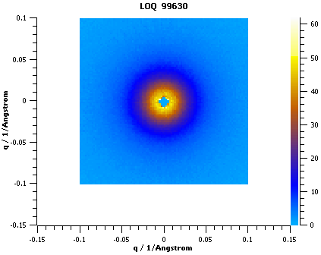
SANS
SANS
  ISIS
    2D reduction
      Pixel and wavelength dependent corrections
      Wavelength cut-offs
    Correctly moving instrument components for transmission and direct runs
  SNS
    User Interface Improvements
      Data catalog tab
    Data stitching
      up to three I(Q) to stitch
    Several other improvements and fixes

Slide 14
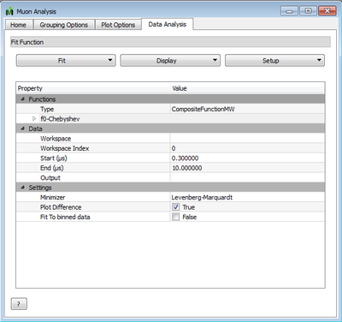
Progress over the last iteration
Muon
  Data Analysis Tab
    Muon specific model optimization
    Results fed to a Results Table Tab
  Dead Time Corrections added

Slide 15
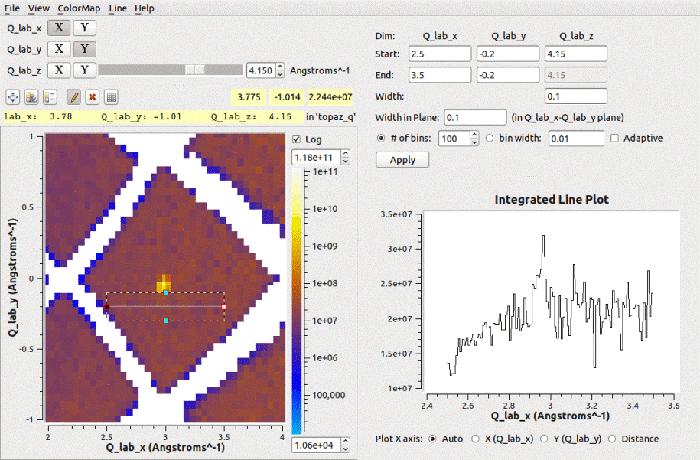
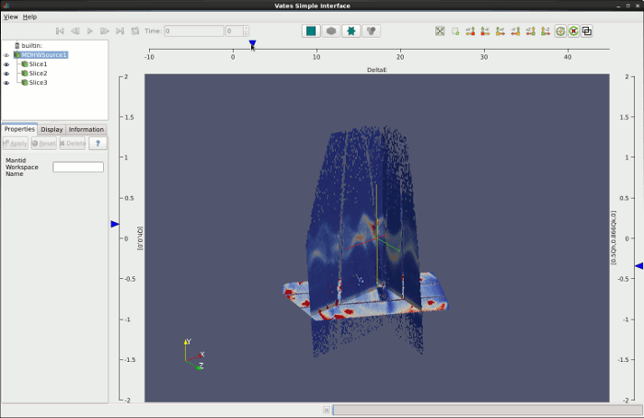
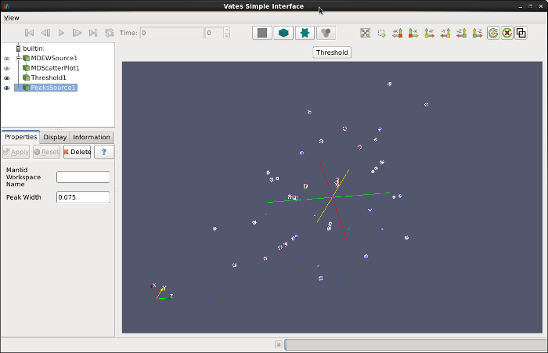
Progress over the last iteration
VATES
  SliceViewer
    2D Visualisation of MD Data
    Extract 1D slices
  VATES Viewer
    UI redesign
    Peak workspace overplotting
    Orthographic mode

Slide 16
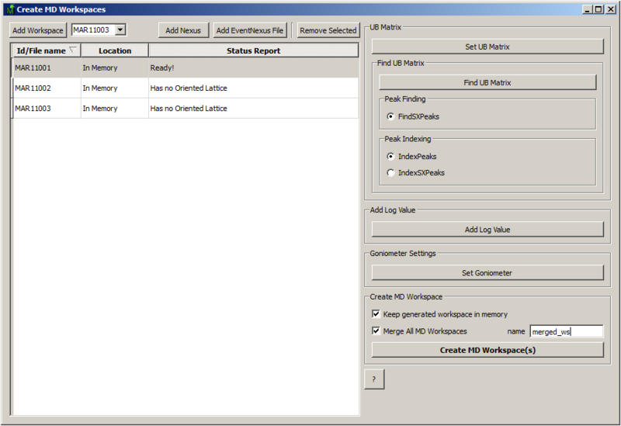
Progress over the last iteration
VATES
  Convert To MD Interface
    Easy to use
  Other
    Binary and Unary Algorithms for MDHistoWorkspaces
    Plotting for MDWorkspaces
    Faster rendering of MDWorkspaces in 3D initial view
    Nearest Neighbours searching much faster
    Paraview 3D viewer communicates with 2D Slice Viewer
    Python interface for real-time control of SliceViewer and LineViewer

Slide 17
Next Release
Target Date
  21st April 2012
Initial implementations for (some or all of):
  Indirect Support – VISION, BASIS
  Reflectometry – data splicing
  Live event viewing & processing
  Automated Reduction
  Data Chunking and distributed processing
  Python Algorithm support for New API
  Quantification for VATES

